Slide 1
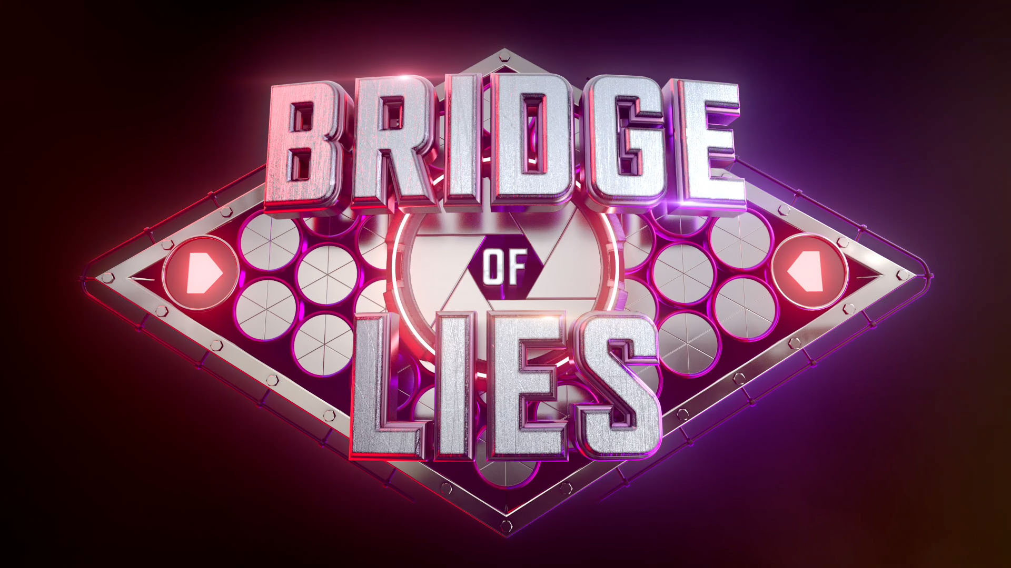


Slide 2
Parts of a Ukulele
Any item that is NOT part
of a Ukulele is a LIE

Slide 3
Parts of a Ukulele
Strings
Mirror
Any item that is NOT part
of a Ukulele is a LIE

Slide 4
Parts of a Ukulele
Door
Floor Tom
Fret Board
Violin
Handle
Any item that is NOT part
of a Ukulele is a LIE

Slide 5
Parts of a Ukulele
Screw
Trumpet
Floor Tom
Arch
Cabasa
Violin
Hand
Clarinet
Neck
Any item that is NOT part
of a Ukulele is a LIE

Slide 6
Parts of a Ukulele
Sound Hole
Ukulele
Trumpet
Gate
Floor Tom
Euphonium
Cabasa
Door
Violin
Cello
Clarinet
Carpet
Vibraslap
Chord
Any item that is NOT part
of a Ukulele is a LIE

Slide 7
Parts of a Ukulele
Xylophone
Ukulele
Jack
Trumpet
Double Bass
Floor Tom
Euphonium
Headstock
Cabasa
Guitar
Violin
Cello
Cradle
Clarinet
Flute
Vibraslap
Joint
Trombone
Any item that is NOT part
of a Ukulele is a LIE

Slide 8
Parts of a Ukulele
Xylophone
Raisin
Ukulele
Tuba
Trumpet
Double Bass
Flathead
Floor Tom
Euphonium
Flexatone
Cabasa
Guitar
Trim
Violin
Cello
Piccolo
Clarinet
Flute
Nut
Vibraslap
Accordion
Trombone
Kite
Any item that is NOT part
of a Ukulele is a LIE

Slide 9
Parts of a Ukulele
Xylophone
Viola
Ukulele
Tuba
Oboe
Trumpet
Double Bass
Harp
Floor Tom
Euphonium
Flexatone
Key
Cabasa
Guitar
Bassoon
Violin
Cello
Piccolo
Tray
Clarinet
Flute
Guiro
Vibraslap
Accordion
Flute
Trombone
Sitar
Any item that is NOT part
of a Ukulele is a LIE

Slide 10
Parts of a Ukulele
Xylophone
Viola
Ukulele
Tuba
Lute
Trumpet
Double Bass
Harp
Bridge
Floor Tom
Euphonium
Flexatone
Claves
Cabasa
Guitar
Bassoon
Tunnel
Violin
Cello
Piccolo
French Horn
Clarinet
Flute
Guiro
Post
Vibraslap
Accordion
Oboe
Trombone
Sitar
Any item that is NOT part
of a Ukulele is a LIE

Slide 11
Parts of a Ukulele
Xylophone
Viola
Ukulele
Tuba
Lute
Trumpet
Double Bass
Harp
Rattle
Floor Tom
Euphonium
Flexatone
Claves
Waist
Cabasa
Guitar
Bassoon
Recorder
Violin
Cello
Piccolo
French Horn
Leg
Clarinet
Flute
Guiro
Zither
Vibraslap
Accordion
Oboe
Trombone
Sitar
Any item that is NOT part
of a Ukulele is a LIE

Slide 12
Parts of a Ukulele
Xylophone
Viola
Ukulele
Tuba
Lute
Trumpet
Double Bass
Harp
Rattle
Floor Tom
Euphonium
Flexatone
Claves
Kalimba
Cabasa
Guitar
Bassoon
Recorder
Violin
Cello
Piccolo
French Horn
Saxophone
Clarinet
Flute
Guiro
Zither
Vibraslap
Accordion
Oboe
Trombone
Sitar
Any item that is NOT part
of a Ukulele is a LIE
YOU MADE IT!!!

Slide 13
LIE
GAME OVER

Slide 14
CORRECT!

Slide 15
CORRECT!

Slide 16
CORRECT!

Slide 17
CORRECT!

Slide 18
CORRECT!

Slide 19
CORRECT!

Slide 20
CORRECT!

Slide 21
CORRECT!

Slide 22
CORRECT!

