Slide 1
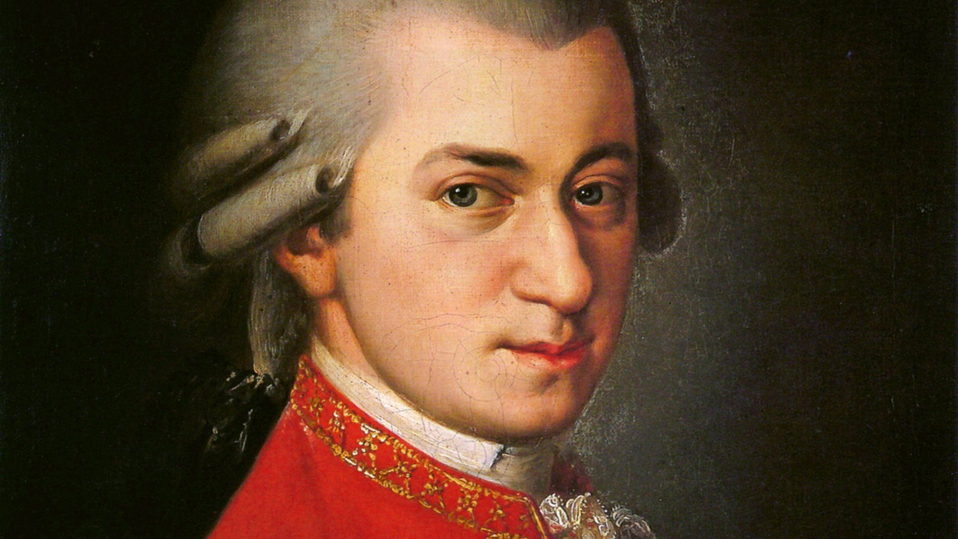
Mozart
Timeline

Slide 2
1756

Slide 3
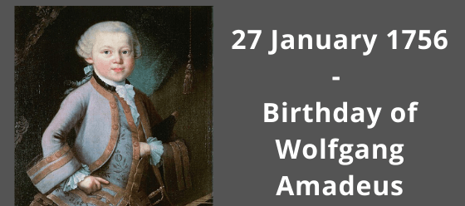
Mozart Born

Slide 4
1760

Slide 5
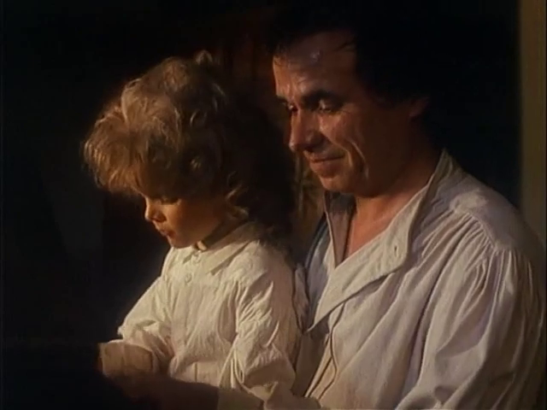
Playing on his Father’s knee at 4 Years of age

Slide 6
1762

Slide 7
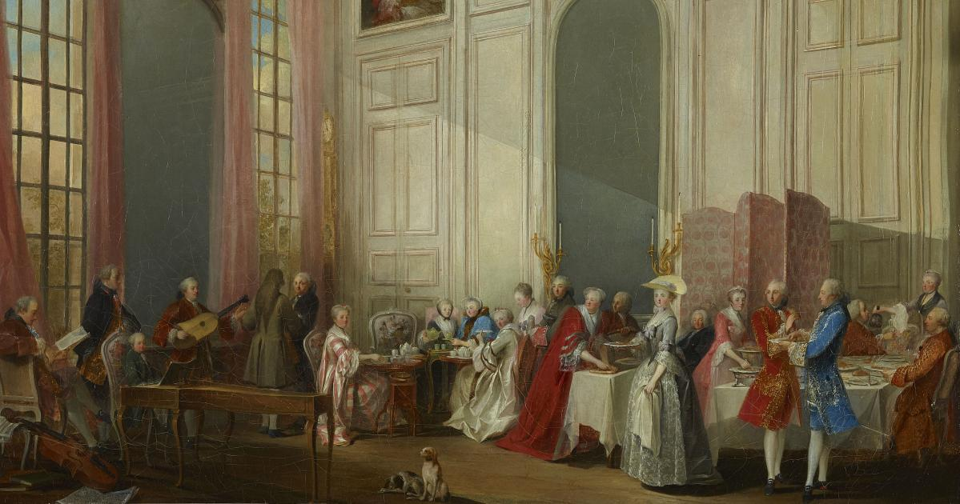
Mozart plays for Royalty at 6 Years of age

Slide 8
1764

Slide 9
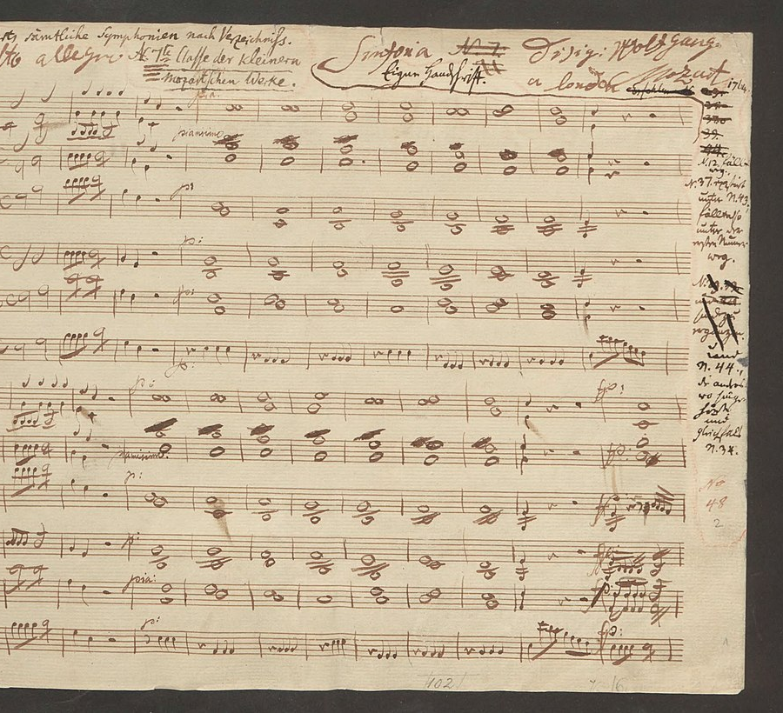
Mozart write first Symphony at 8 Years of Age

Slide 10
1769

Slide 11
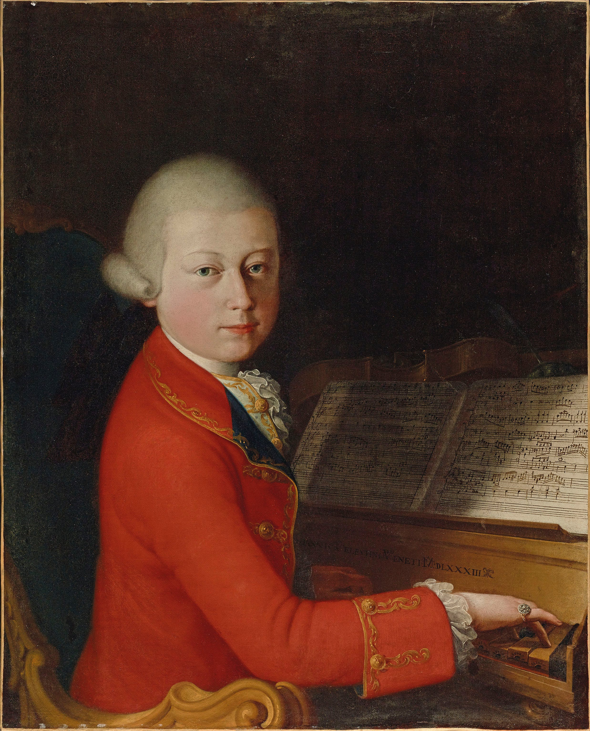
Mozart tours Italy with his Father

Slide 12
1773

Slide 13
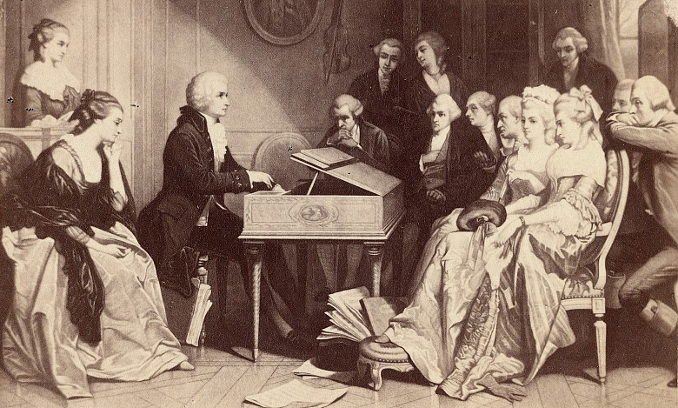
Mozart works at Court Musician at 17 Years of age

Slide 14
1781

Slide 15

Mozart plays for Emperor

Slide 16
1786

Slide 17

Mozart write Horn Concerto

Slide 18
1791

Slide 19
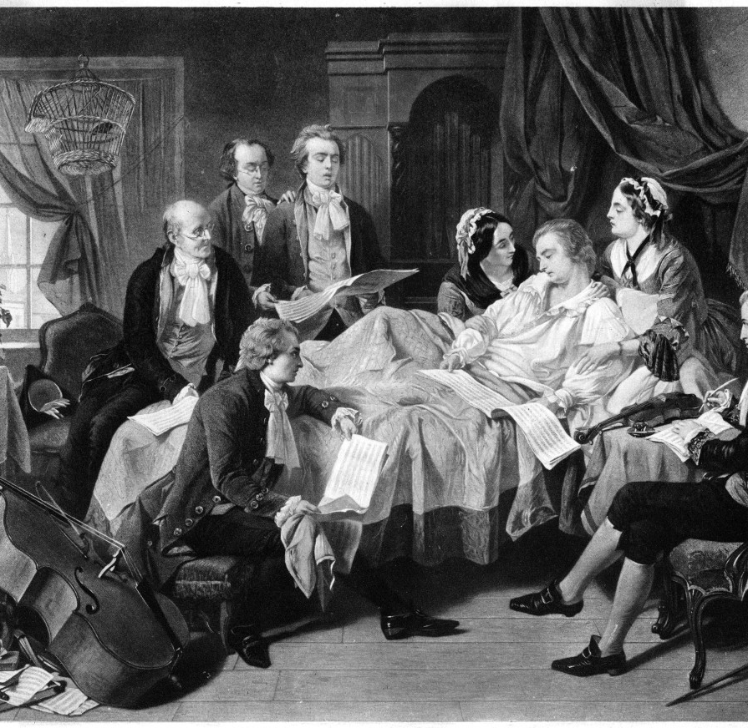
Mozart dies

